Slide 1
R-FCN & RetinaNet
Two quite simple and novel ideas that improved state-of-the-art.

Slide 2
Translation
Invariance -> Classification
Deep fully convolutional networks
Variance -> Object detection
ResNet: RoI pooling layer between convolutions
Meh
Not fully convolutional
Notes:
CNN which is the backbone of the methods used here are location invariant
So we need to introduce translation variance
RoIs between convolutions introduce subnets making training slower

Slide 3
R-FCN
Region-based Fully Convolutional Network

Slide 4
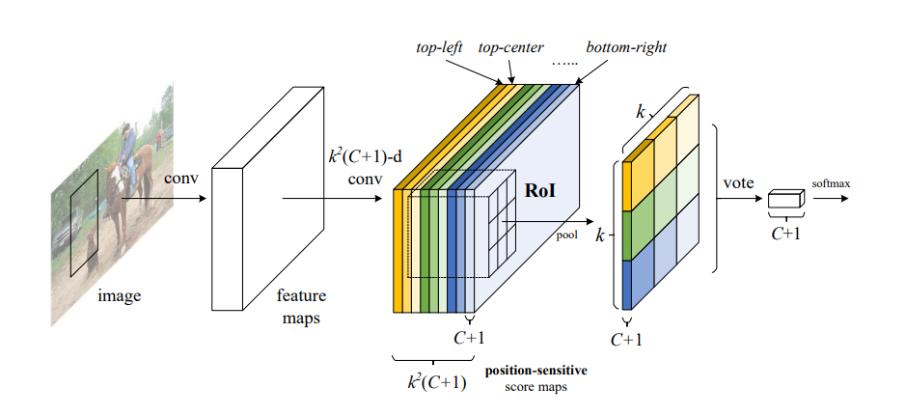
Overview
Two-stage object detection
RPN - Region Proposal network (fully convolutional)
R-FCN (fully convolutional)
Feature maps -> position sensitive score maps
Ends with position sensitive RoI-pooling layer
Average and softmax for output
Notes:
Two-stage popular from before, there exists without, but RoIs lead to the best architectures per 2017.
RPN should have been explained by R-CNN.
In this illustration, there are k × k = 3 × 3 position-sensitive score maps generated by a fully convolutional network. For each of the k × k bins in an RoI, pooling is only performed on one of the k 2 maps (marked by different colors).
Note how late the location variance is introduced in the network.

Slide 5
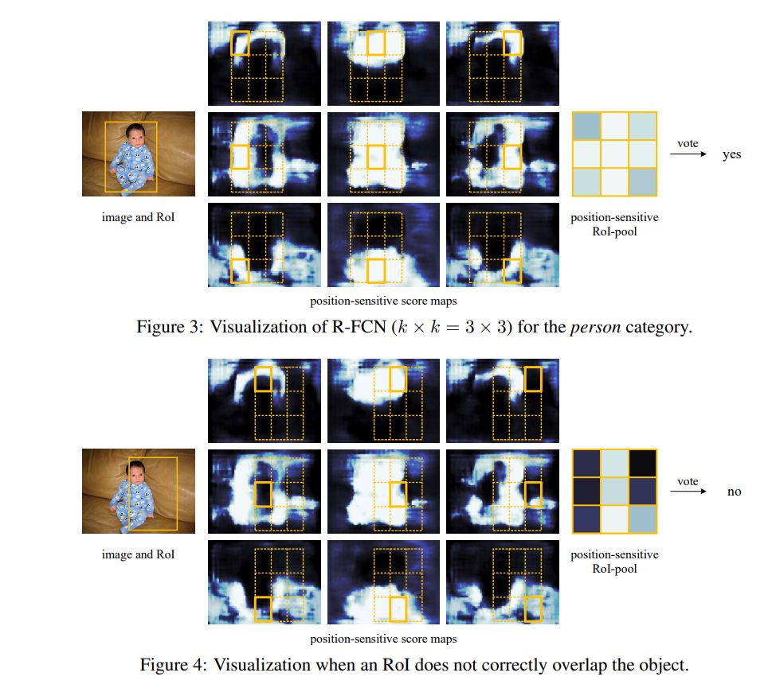
Position sensitive
Score maps
Here: k=3
One map for each position and class
Notes:
Babys are qute.
The idea is that parts of an object can help identify the object. I.e. right in in the left of a region indicates that the region contains a face. Here, for babies we can see...
This is done to explicitly code in position information.
If a candidate box precisely overlaps with a true object (Figure 3), most of the k 2 bins in the RoI are strongly activated, and their voting leads to a high score. On the contrary, if a candidate box does not correctly overlaps with a true object (Figure 4), some of the k 2 bins in the RoI are not activated, and the voting score is low.
Note how the position sensitive score maps are the same for both regions. (FCN!!!)

Slide 6
Training
RoI-loss = sum of cross-entropy loss and box regression loss
Easy to adopt Online Hard Example mining (OHEM)
Negligible per-RoI cost
Uses all RoIs
Notes:
Sum for ALL RoI-s. This means that they use everything for faster training.

Slide 7
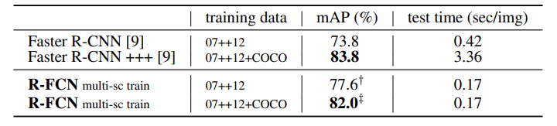
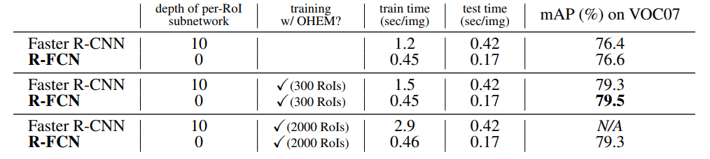
Speed and Accuracy
Simple & fast architecture
Notes:
Key points:
FAST! (w/better or comparable accuracy)
For comparable acccuracy 20x faster.
Can be trained w/OHEM | note last row
Increase RoI - no scale time

Slide 8
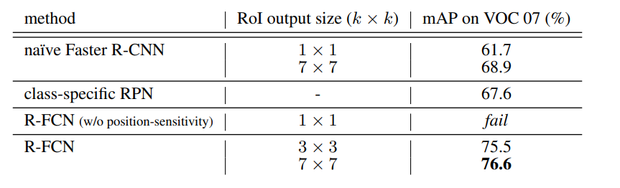
Comparison to other
fully-convolutional networks
Notes:
Note the fail for 1x1 R-FCN
This equals removing the position-sensitive part of the network, which is what makes it work.
Much better than the other things

Slide 9
RetinaNet
The loss function is the cool thing.
Notes:
Gon talk boot network as well, but not in-depth at it’s main function was to show that the loss-functions works.

Slide 10
Overview
One-stage object detection
Huge potential, but no results as of 2018
Key problem: Foreground - background class imbalance
Many (100k) candidate locations but few with objects
Focal Loss first
Reimagined loss function to tackle key problem
RetinaNet second
Simple FCN detector to test loss function
Notes:
The two-stage encoders have an advantage since the proposed RoIs often overlap with some object. That’s after all the job of RPN and the like.
Focal loss intend to give a similar mechanism to one-stage detection, balancing the training set

Slide 11
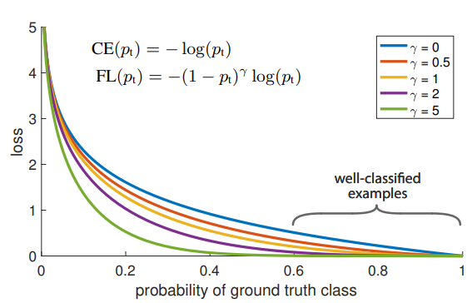

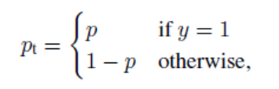
Focal loss
Reduce relative loss on well-classified examples
Focus on hard, misclassified examples
Can also add class weights
Slight improvement
Notes:
The term before CE is kind of a weighing term for hard examples.
gamma=0 ⇒ FL=CE
Gamma = 2 is good in practice, don’t need something more extreme.
FunFact: there has been a lot of work on robust loss-functions, downweighing outliers (hard examples). This does the exact opposite, showing that designing a loss-function for a problem is anything but trivial

Slide 12
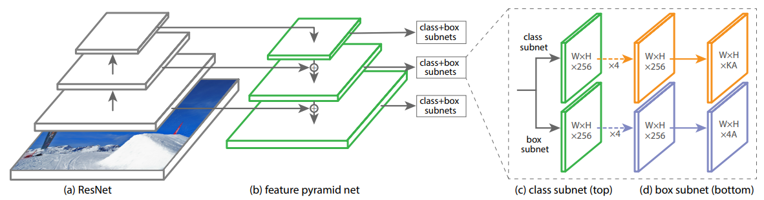
RetinaNet Detector
Backbone
Convolutional feature map entire image
Feature Pyramid Network on ResNet
Subnetworks
Object classification
Small FCN
Bounding box regression
Small FCN
Notes:
Experiments without FPN yielded low AP
The two subnets are identical save for output, but they do not share weights. (the papaer mentioned it, so I’ll do the same)
Only decode box predictions from at most 1k top-scoring predictions per FPN-level

Slide 13
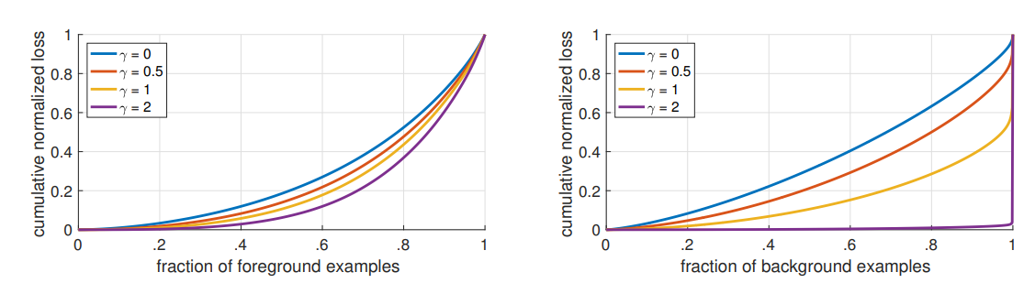
Focal Loss analysis
Large impact on distribution over negative samples
Notes:
They normalized loss between 0-1 and plotted the Cumulative density Function.
This shows where the loss is large, by looking at how steep the slope is. (dunno if this is best way to show.
Easy negatives don’t have impact on loss-functino -> focus on the hard ones.

Slide 14
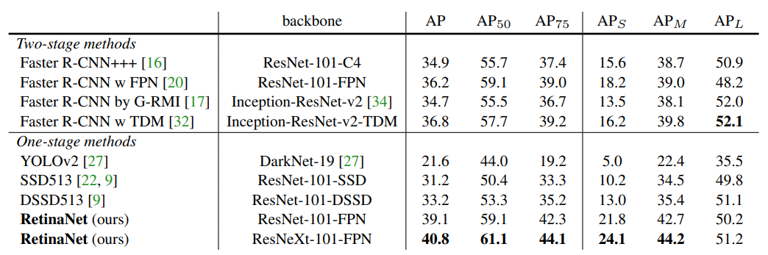
Accuracy
COCO dataset
Notes:
The only thing I really want to show here is how well they perform. This shows how much a good loss-function can help focus the training of the network.

Slide 15
Questions?

